Slide 1
ICORT-25
Exhibition Hall Layout
Updated on date: 28-2-25

Slide 2
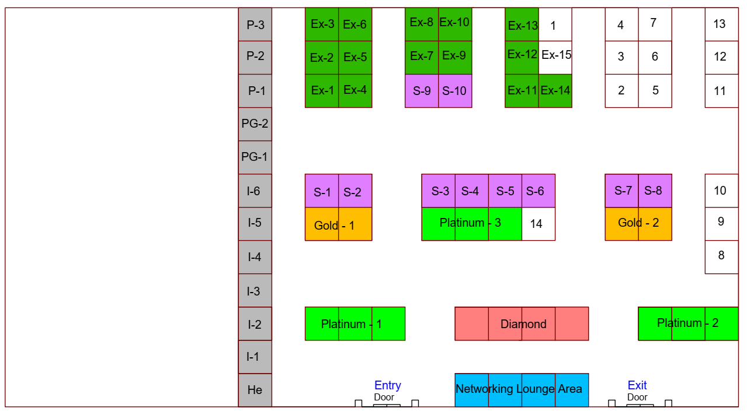
ICORT – 2025 at NOCCI, Balasore, 6 – 8 March 2025
Exhibitor Section
Ex1: Logicspectra Tech
Ex2: Telerad Tech
Ex3: Telerad Tech
Ex4: Aqila Tech
Ex5: SBI, Chandipur
Ex6: Improsys Tech
Ex7: Zetatek Tech
Ex8: Zetatek Tech
Ex9: Schiebel Systems
Ex10: Accveil Solutions
Ex11: Elmack Engg
Ex12: Glorich India
Ex13: Rudra Power
Ex14: Constelli Signals
Ex15: Medical Help
Univ. / Institute Section
UI1: FM University
UI2: IIT, Bhubaneswar
UI3: Burdwan Univ
UI4: XIM, Bhubaneswar
UI5: VSSUT, Burla
UI6: Jadavpur University
UI7: Berhampur University
UI8: IIT, Kharapur
UI9: NIT, Rourkela
UI10: Fire Prevention Demo Stall
UI11: IIIT, Naya Raipur
UI12: Maharaja SCBD University
UI13: PM Shri Kendriya Vidyalaya
UI14: IEEE Hall
Exhibitor Section
Diamond: Anadrone
P1: Safran Data Systems
P2: Weibel Scientific A/S
P3: AMPL
G1: Optonet Tech
G2: SCI
S1: Data Patterns
S2: Semco
S3: Pan Intellecom
S4: Janus Trading
S5: Park Controls
S6: Accord Systems
S7: Reserved Hall
S8: Reserved Hall
S9: Cadfem India
S10: Schiebel Systems
ICORT Stalls
He: Help Desk
I1-I6: ITR Pavilion
PG1-PG2: Display Stall
P1-P3: PXE Pavilion
NL: Networking Lounge Area
P: Platinum, G: Gold, S: Silver, Ex: Exhibitor, UI: University/Institute
He: Help Desk, I: ITR and P: PXE

